Slide 1
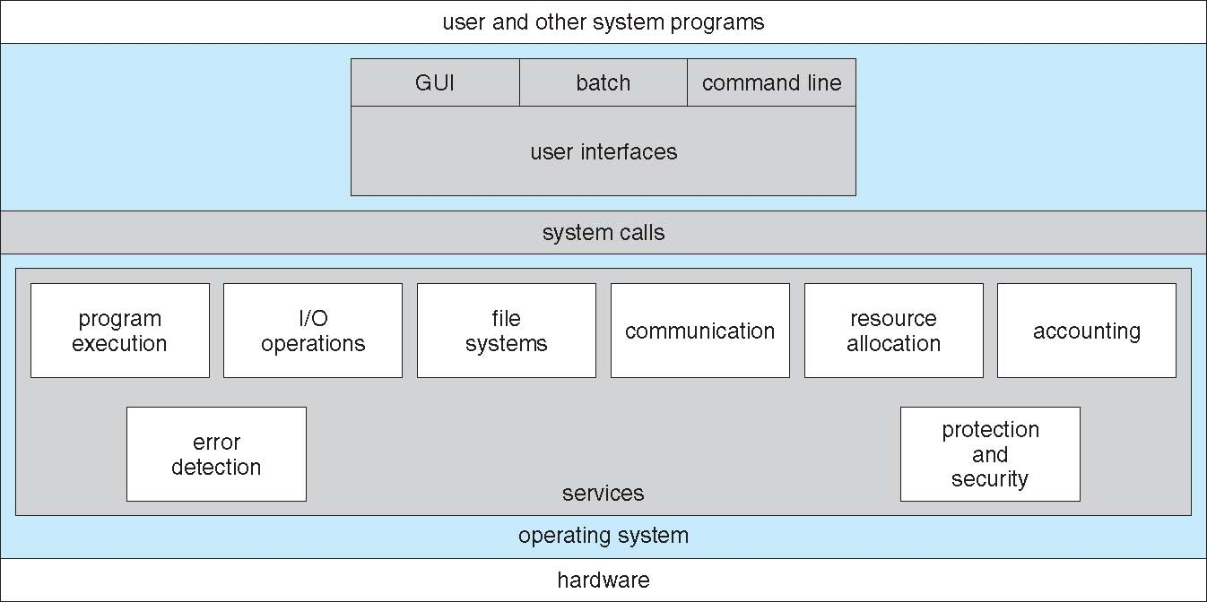
System structure
2.1 Operating system services
An operating system provides an environment for the execution of programs. It provides certain services to programs and to the users of those programs. The specific services provided, of course, differ from one operating system to another, but we can identify common classes. Following figure shows one view of the various operating-system services and how they interrelate.

Slide 2
Continued….
User interface. Almost all operating systems have a user interface. This interface can take several forms. One is a DTrace command line interface(CLI) which uses text commands and a method for entering them(say, a program to allow entering and editing of commands). Another is a batch interface in which commands and directives to control those commands are entered into files, and those files are executed. Most commonly, a graphical user interface is used.
Program execution. The system must be able to load a program into memory and to run that program. The program must be able to end its execution, either normally or abnormally (indicating error).
I/O operations. A running program may require I/0, which may involve a file or an I/0 device. For specific devices, special functions may be desired (such as recording to a CD or DVD drive or blanking a display screen). For efficiency and protection, users usually cannot control I/0 devices directly. Therefore, the operating system must provide a means to do I/0.
File-system manipulation. The file system is of particular interest. Obviously, programs need to read and write files and directories. They also need to create and delete them by name, search for a given file, and list file information. Finally, some programs include permissions management to allow or deny access to files or directories based on file ownership.

Slide 3
Continued….
Communications. There are many circumstances in which one process needs to exchange information with another process. Such communication may occur between processes that are executing on the same computer or between processes that are executing on different computer systems tied together by a computer network. Communications may be implemented via shared memory or through message passing.
Error detection. The operating system needs to be constantly aware of possible errors. Errors may occur in the CPU and memory hardware (such as a memory error or a power failure), in I/0 devices (such as a parity error on tape, a connection failure on a network, or lack of paper in the printer), and in the user program (such as an arithmetic overflow, an attempt to access an illegal memory location). For each type of error, the operating system should take the appropriate action to ensure correct and consistent computing.

Slide 4
Continued…
Another set of operating-system functions exists not for helping the user but rather for ensuring the efficient operation of the system itself.
Resource allocation: When there are multiple users or multiple jobs running at the same time, resources must be allocated to each of them. Many different -types of resources are managed by the operating system such as CPU cycles, main memory, and file storage.
Accounting: we want to keep track of which users use how much and what kinds of computer resources. This record keeping may be used for accounting or simply for accumulating usage statistics.
Security of the system from outsiders is also important. Such security starts with requiring each user to authenticate himself or herself to the system, usually by means of a password, to gain access to system resources.

Slide 5
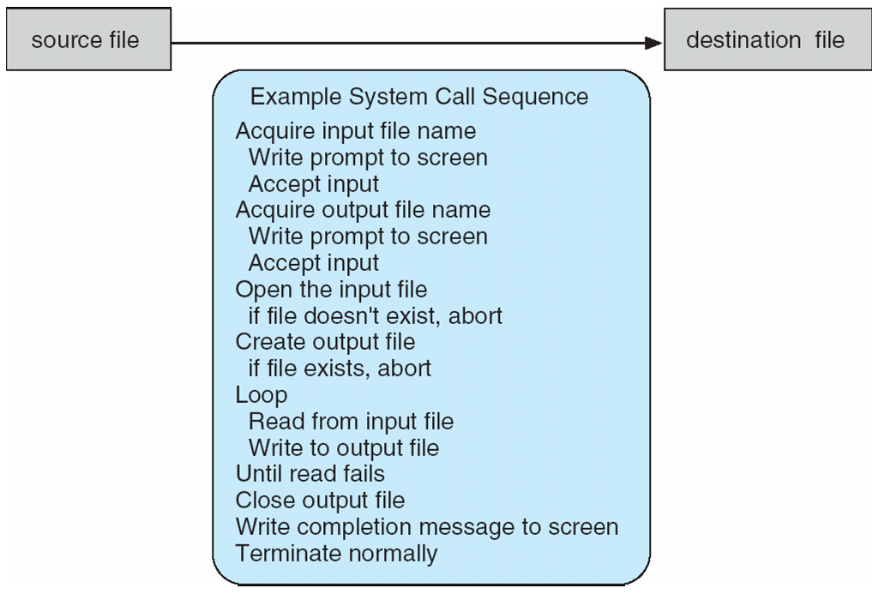
2.3 system call
System calls provide an interface to the services made available by an operating system. These calls are generally available as routines written in C and C++.
System call sequence to copy the contents of one file to another file.

Slide 6
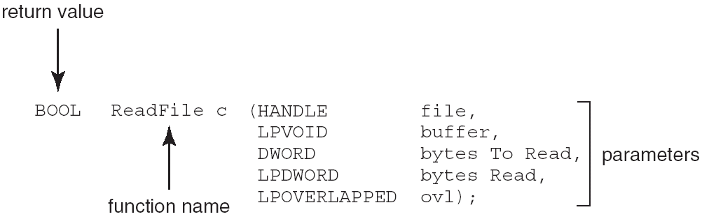
Continued….
Application programming interface(API) : specifies a set of functions that are available to application programmer, including the parameters that are passed to each function and the return values the programmer can expect.
Example of Standard API
Consider the ReadFile() function in the
Win32 API—a function for reading from a file
A description of the parameters passed to ReadFile()
HANDLE file—the file to be read
LPVOID buffer—a buffer where the data will be read into and written from
DWORD bytesToRead—the number of bytes to be read into the buffer
LPDWORD bytesRead—the number of bytes read during the last read
LPOVERLAPPED ovl—indicates if overlapped I/O is being used

Slide 7
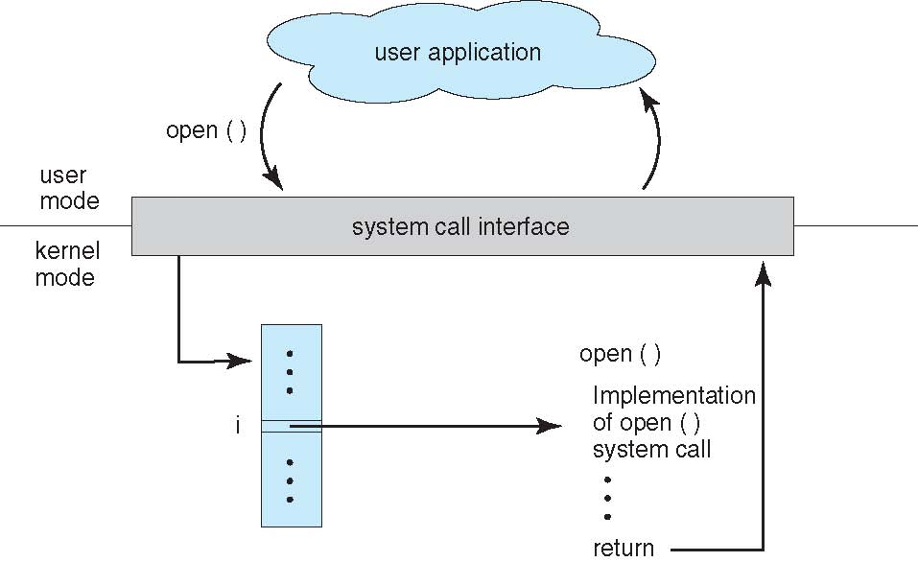
Continued…
The relationship between an API, the system-call interface, and the operating system is shown in Figure 2.6, which illustrates how the operating system handles a user application invoking the open() system call.

Slide 8
System Call Parameter Passing
Three general methods used to pass parameters to the OS
Simplest: pass the parameters in registers
In some cases, may be more parameters than registers
Parameters stored in a block, or table, in memory, and address of block passed as a parameter in a register
This approach taken by Linux and Solaris
Parameters placed, or pushed, onto the stack by the program and popped off the stack by the operating system
Block and stack methods do not limit the number or length of parameters being passed
Notes:
8
8

Slide 9
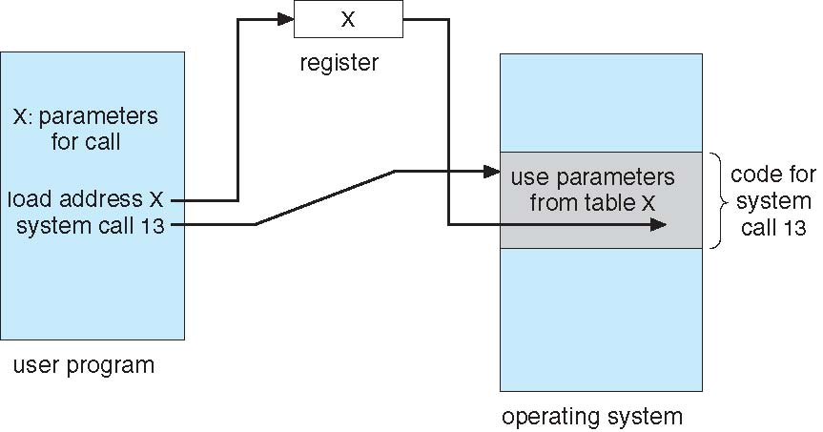
Parameter Passing via Table
Notes:
9
9

Slide 10
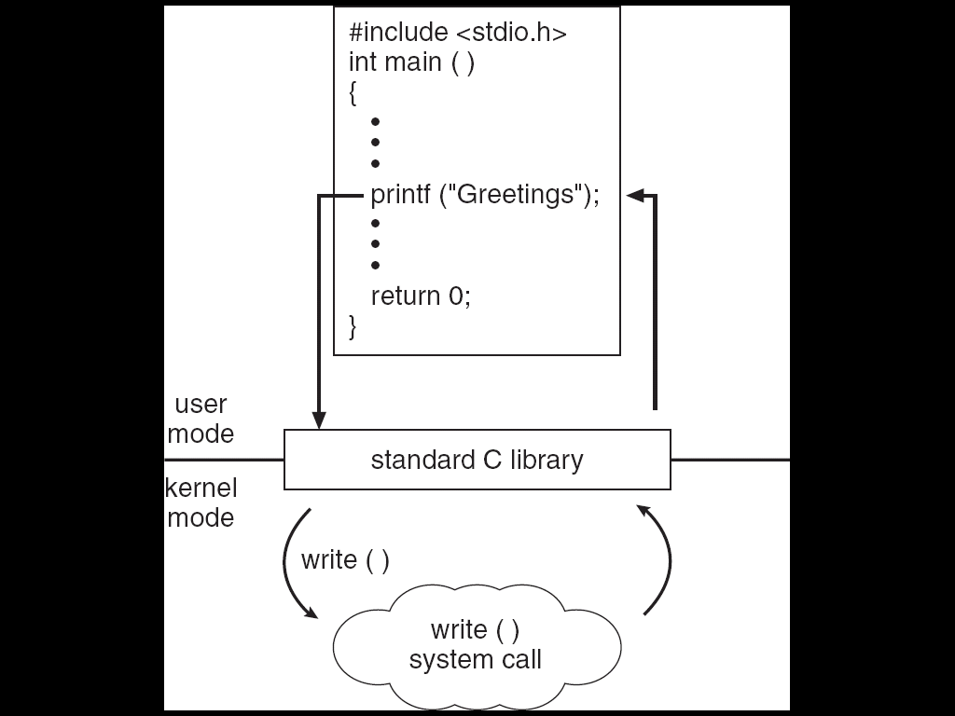
C program invoking printf() library call, which calls write() system call.

Slide 11
2.4 Types of system calls
System calls can be grouped roughly six major categories:
Process control
file manipulation
Device manipulation
information maintenance
Communication
Protection

Slide 12
Continued…
Process control
End process, abort process
Load process, execute process
create process, terminate process
get process attributes, set process attributes
wait for time
wait event, signal event
allocate and free memory
File management
create file, delete file
open, close file
read, write, reposition
get and set file attributes

Slide 13
Continued…
Device management
request device, release device
read, write, reposition
get device attributes, set device attributes
logically attach or detach devices
Information maintenance
get time or date, set time or date
get system data, set system data
get and set process, file, or device attributes
Communications
create, delete communication connection
send, receive messages
transfer status information
attach and detach remote devices

Slide 14
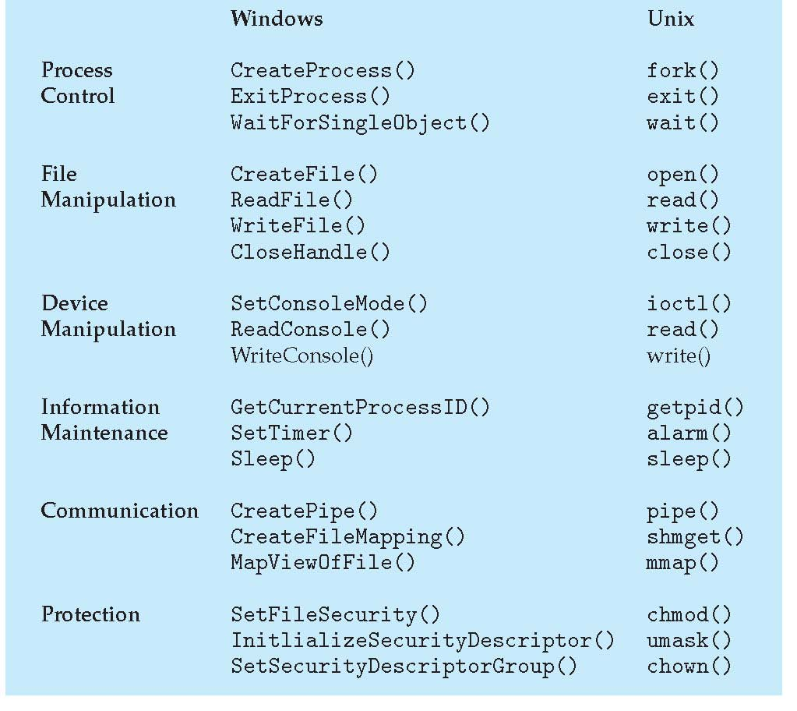
Continued….
Examples of Windows and Unix System Calls

Slide 15
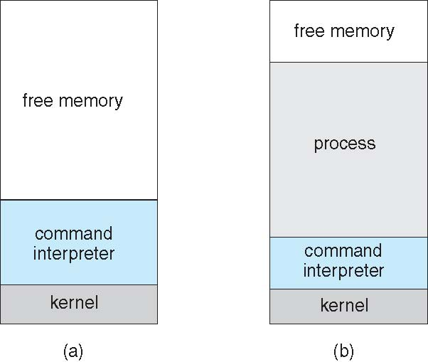
Continued….
Example: MS-DOS
Single tasking operating system.
MS-DOS execution (a)at system startup (b)running a program

Slide 16
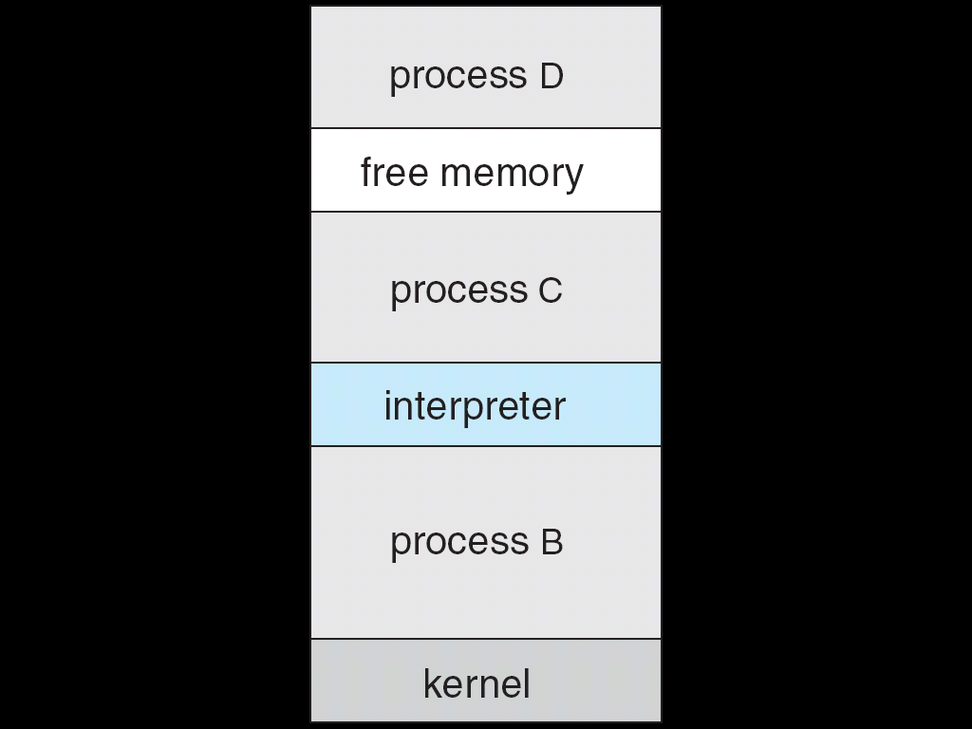
Continued…..
FreeBSD
Unix variant
Multitasking
User login -> invoke user’s choice of shell
To start new process Shell executes fork() system call to create process and exec() system call to load process.
FreeBSD Running Multiple Programs

Slide 17
2.7 Operating system structure
A system as large and complex as a modern operating system must be engineered carefully if it is to function properly and be modified easily. A common approach is to partition the task into small components rather than have one monolithic system.
1. Simple structure 2. layered 3. microkernel 4. modular system
2.7.1 simple structure
Many commercial operating systems do not have well-defined structures. Frequently, such systems started as small, simple, and limited systems and then grew beyond their original scope.
MS-DOS is an example of such a system.
It was written to provide the most functionality in the least space, so it was not divided into modules carefully. For example application programs are able to access I/O routines to write directly to display devices and disk drives but entire system crashes if program fails. Following figure shows its structure.

Slide 18
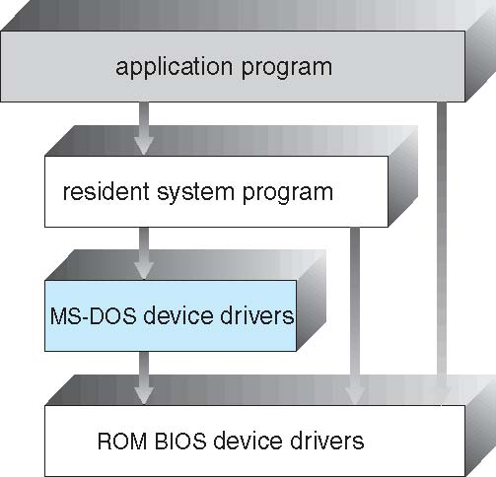
Continued…

Slide 19
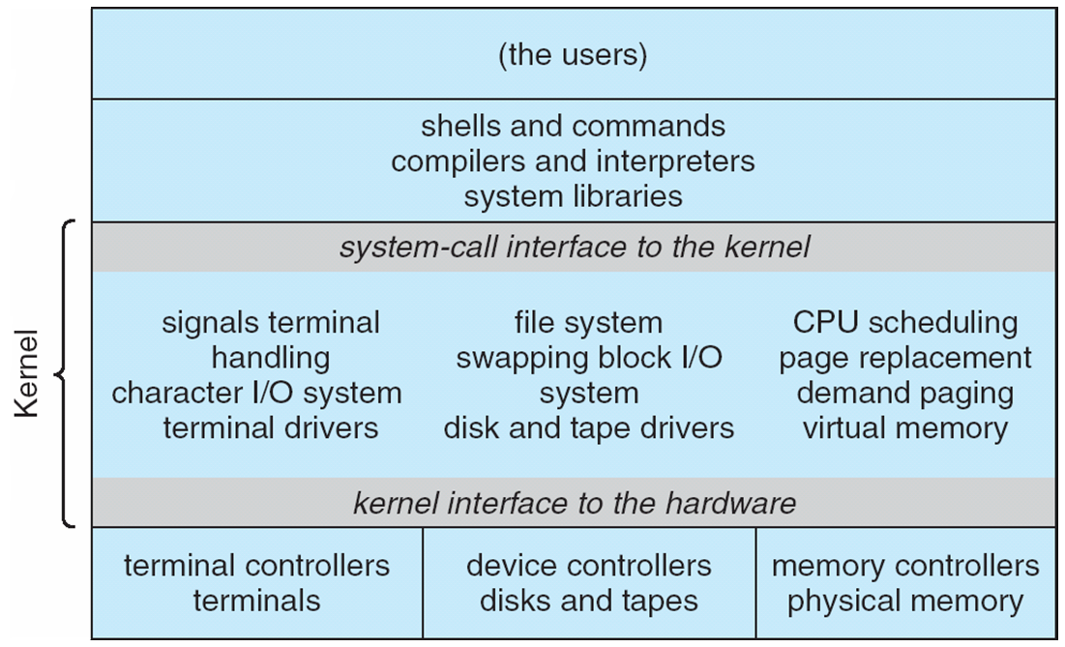
Continued….
Another example of limited structuring is the original UNIX operating system. Like MS-DOS, UNIX initially was limited by hardware functionality.
It consists of two separate parts the kernel and system programs.
Figure shows Traditional UNIX System Structure.

Slide 20
Continued….
Advantage of simple structure
Simple , small and limited system and grow beyond their original scope.
Disadvantages of simple structure
In MS-DOS, the interfaces and levels of functionality are not well separated. For instance, application programs are able to access the basic I/O routines to write directly to the display and disk drives. Such freedom causes entire system to crash when user programs fail.
No hardware protection and no dual mode operation.

Slide 21
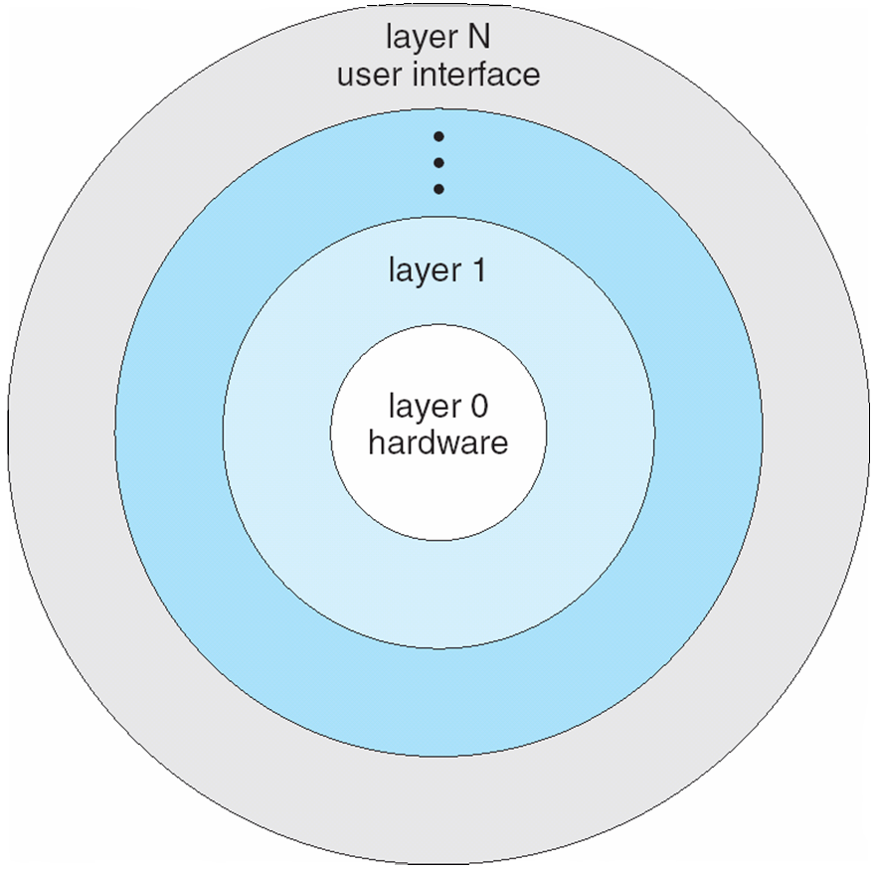
2.7.2 Layered approach
With proper hardware support, operating systems can be broken into pieces that are smaller and more appropriate than MS-DOS and UNIX.
In layered approach, the operating system is broken into a number of layers(levels).
The bottom layer is hardware (layer 0) and highest layer(layer N) is user interface. The following figure shows layered structure.
An operating-system layer is an implementation of an abstract object made up of data and the operations that can manipulate those data.

Slide 22
Continued….
Advantages of layered approach
Simple to construct and debug.
The operating system can then retain much greater control over the computer and over the applications that make use of that computer.
The layers are selected so that each uses functions (operations) and services of only lower-level layers. This approach simplifies debugging and system verification.
Provides information hiding.
Disadvantages of layered approach
The major difficulty with the layered approach involves appropriately defining the various layers. Because a layer can use only lower-level layers, careful planning is necessary.
they tend to be less efficient than other types. For instance, when a user program executes an I/0 operation, it executes a system call that is trapped to the I/0 layer, which calls the memory-management layer which in turn calls the CPU-scheduling layer, which is then passed to the hardware.

Slide 23
2.7.3 Microkernels
We have already seen that as UNIX expanded, the kernel became large and difficult to manage.
University developed an operating system called Mach that modularized the kernel using the microkernel approach.
This method structures the operating system by removing all nonessential components from the kernel and implementing them as system and user level programs. The result is smaller kernel called microkernel.
Microkernel provides minimal process and memory management.
The main function of the micro kernel is to provide a communication facility between the client program and the various services that are also running in user space.
Advantages:
Easy to extend operating system.
Easy to port operating system from one hardware design to other.
It provides more security and reliability.
Disadvantages
decreased performance due to increased system function overhead.

Slide 24
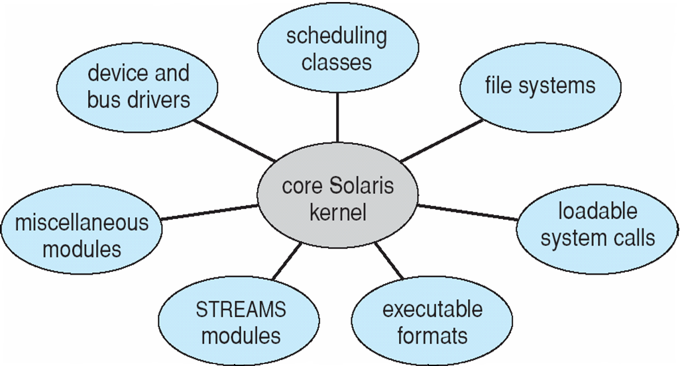
2.7.4 Modules (modular approach)
Perhaps the best current methodology for operating-system design involves using object-oriented programming techniques to create a modular kernel.
Here, the kernel has a set of core components and links in additional services either during boot time or during run time.
For example, the Solaris operating system structure, shown in Figure, is organized around a core kernel with seven types of loadable kernel modules:
Scheduling classes
File systems
Loadable system calls
Executable formats
STREAMS modules
Miscellaneous
Device and bus drivers

Slide 25
Continued….
The overall result resembles a layered system in that each kernel section has defined, protected interfaces; but it is more flexible than a layered system in that any module can call any other module.
Furthermore, the approach is like the microkernel approach in that the primary module has only core functions and knowledge of how to load and communicate with other modules; but it is more efficient, because modules do not need to invoke message passing in order to communicate.
The Apple Mac OS X operating system in following figure uses a hybrid structure. It is a layered system in which one layer consists of the Mach microkernel.
The top layers include application environments and a set of services providing a graphical interface to applications. Below these layers is the kernel environment, which consists primarily of the Mach microkernel and the BSD kernel.

Slide 26
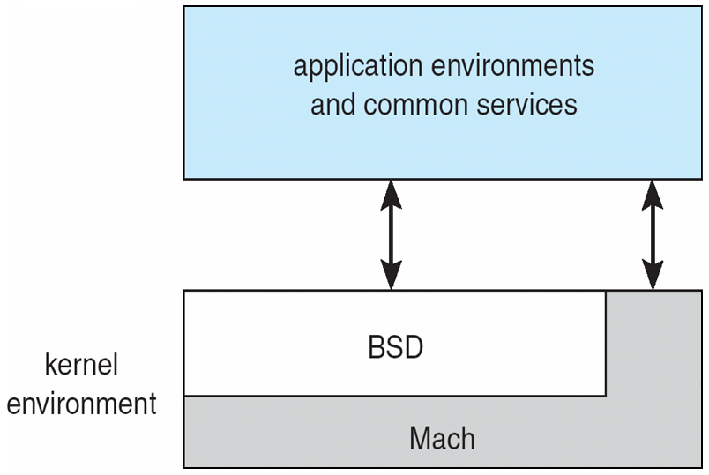
Continued..
Mach provides memory management; support for remote procedure calls (RPCs) and interprocess communication (IPC) facilities, including message passing.
The BSD component provides a BSD command line interface, support for networking and file systems.

Slide 27
System Boot
When power initialized on system, execution starts at a fixed memory location
Firmware ROM used to hold initial boot code
Operating system must be made available to hardware so hardware can start it
Small piece of code – bootstrap loader, stored in ROM or EEPROM locates the kernel, loads it into memory, and starts it
Sometimes two-step process where boot block at fixed location loaded by ROM code, which loads bootstrap loader from disk
Common bootstrap loader, GRUB, allows selection of kernel from multiple disks, versions, kernel options
Kernel loads and system is then running
Notes:
27
27

